Slide 1
Aws storage gateway
ow

Slide 2
Amazon s3 file gateway
Amazon S3 File Gateway – Amazon S3 File Gateway supports a file interface into Amazon Simple Storage Service (Amazon S3) and combines a service and a virtual software appliance. By using this combination, you can store and retrieve objects in Amazon S3 using industry-standard file protocols such as Network File System (NFS) and Server Message Block (SMB).
You deploy the gateway into your on-premises environment as a virtual machine (VM) running on VMware ESXi, Microsoft Hyper-V, or Linux Kernel-based Virtual Machine (KVM), or as a hardware appliance that you order from your preferred reseller. You can also deploy the Storage Gateway VM in VMwareCloud on AWS, or as an AMI in Amazon EC2

Slide 3
..
You can store and retrieve files directly using the NFS version 3 or 4.1 protocol.
You can store and retrieve files directly using the SMB file system version, 2 and 3 protocol.
You can access your data directly in Amazon S3 from any AWS Cloud application or service.
You can manage your S3 data using lifecycle policies, cross-region replication, and versioning. You can think of a S3 File Gateway as a file system mount on Amazon S3

Slide 4
How it works
Setup & Activation
Deploy using a VM image or Amazon EC2 instance.
Activate via AWS Management Console or Storage Gateway API.
Connecting to Amazon S3
Create and configure a file share linked to an Amazon S3 bucket.
Supports NFS (for Linux/macOS) and SMB (for Windows).

Slide 5
..
File & Object Synchronization
Files stored in the file share become objects in S3 (file path = object key).
Changes to files are asynchronously updated in S3.
Existing S3 objects appear as files in the file system.
Security & Data Transfer
Uses SSE-S3 (server-side encryption) for data protection.
Transfers data securely via HTTPS.
Uses MD5 checksum for data integrity; if a mismatch occurs, the gateway retries the request.

Slide 6
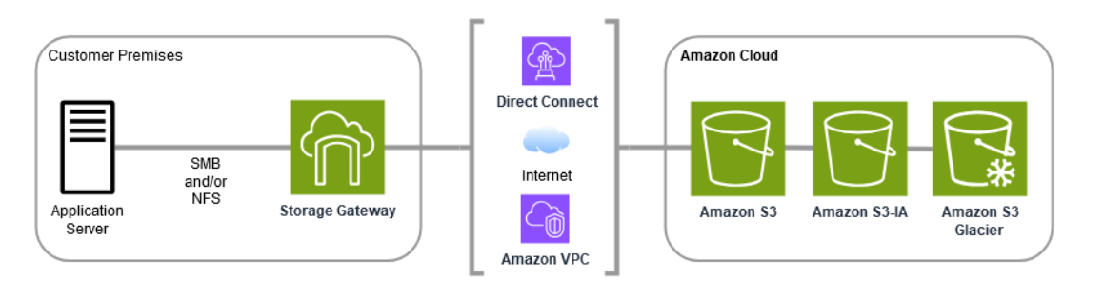
..
S3 File Gateway converts files to S3 objects when uploading files to Amazon S3. The interaction between file operations performed against files shares on S3 File Gateway and S3 objects requires certain operations to be carefully considered when converting between files and objects.

Slide 7
..
When a file is written to the S3 File Gateway by an NFS or SMB client, the File Gateway uploads the file's data to Amazon S3 followed by its metadata, (ownerships, timestamps, etc.). Uploading the file data creates an S3 object, and uploading the metadata for the file updates the metadata for the S3 object. This process creates another version of the object, resulting in two versions of an object. If S3 Versioning is turned on, both versions will be stored.
When a file is modified in the S3 File Gateway by an NFS or SMB client after it has been uploaded to Amazon S3, the S3 File Gateway uploads the new or modified data instead of uploading the whole file. The file modification results in a new version of the S3 object being created

Slide 8
lab
Getting started!!

Slide 9
Overview about s3
Slides
How to create s3 bucket
Versioning in s3 bucket
Lifecycle about s3 bucket
Labs

Slide 10
Storage gateway appliance
To set up your Storage Gateway, you first choose the type of gateway you want to create and the host platform on which you will run the gateway virtual appliance.
You then download the gateway virtual appliance template for the platform of your choice and deploy it in your on-premises environment.
You can also deploy your Storage Gateway as a physical hardware appliance that you order from your preferred reseller, or as an Amazon EC2 instance in your AWS cloud environment.
When you deploy the gateway appliance, you allocate local physical disk space on the virtualization host.

Slide 11
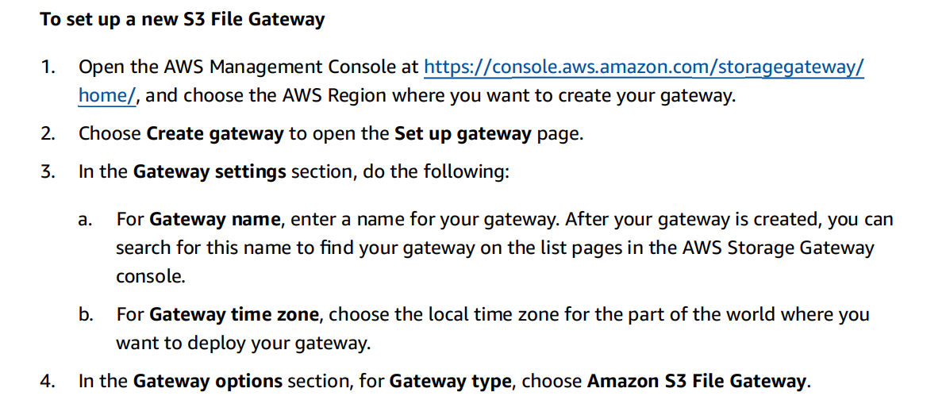
..

Slide 12
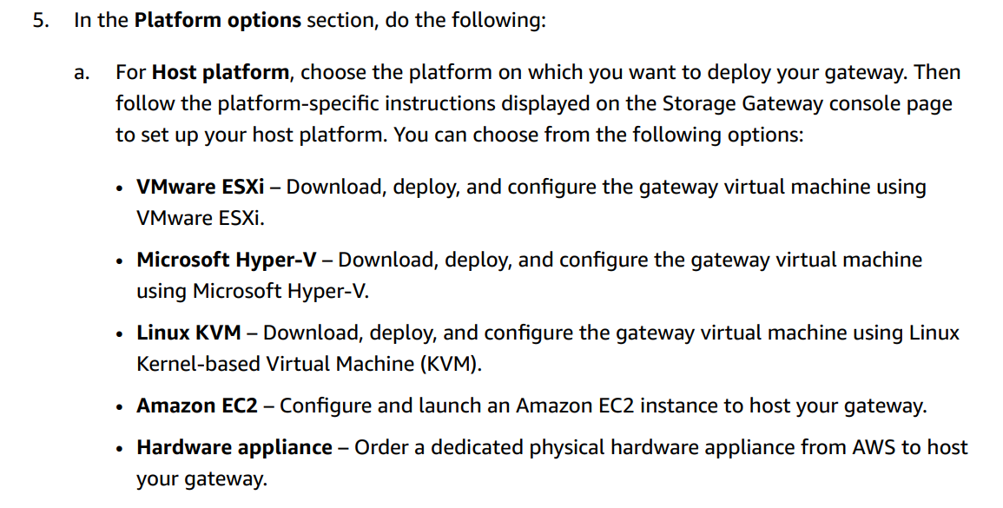
..

Slide 13
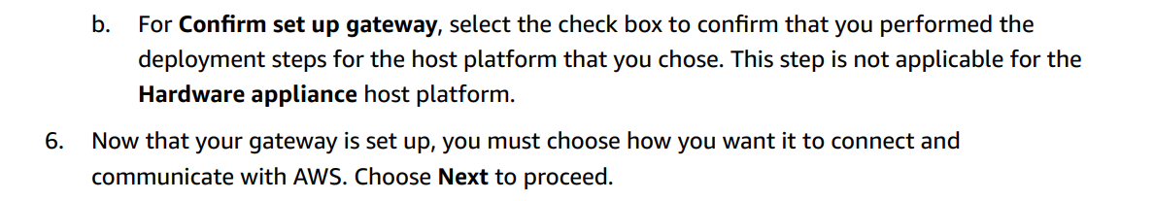
..

Slide 14
lab
Setup the appliance

Slide 15
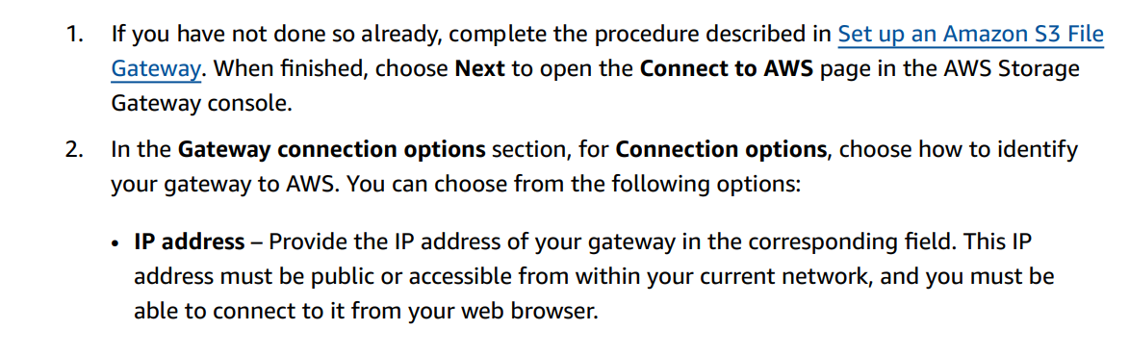
Connect to storage gw

Slide 16
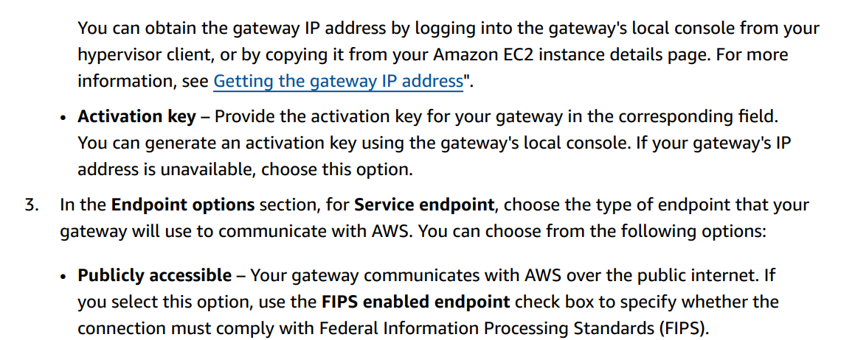
..

Slide 17
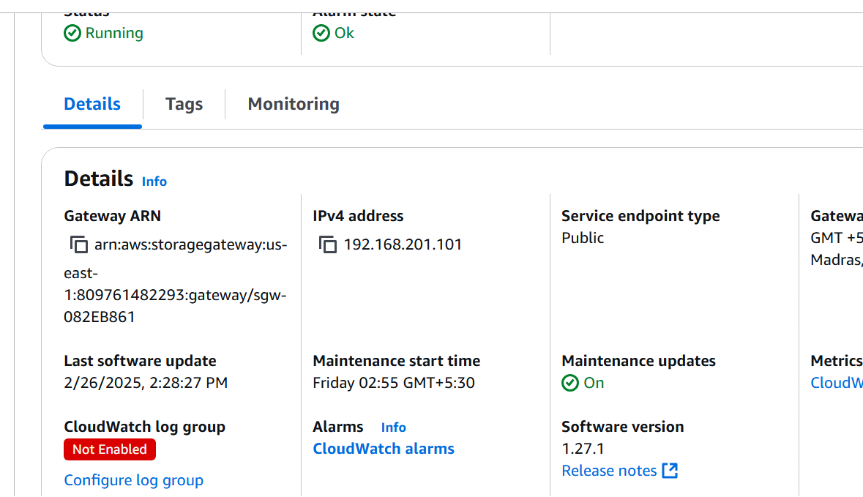
..

Slide 18
lab
Setup the gateway

Slide 19
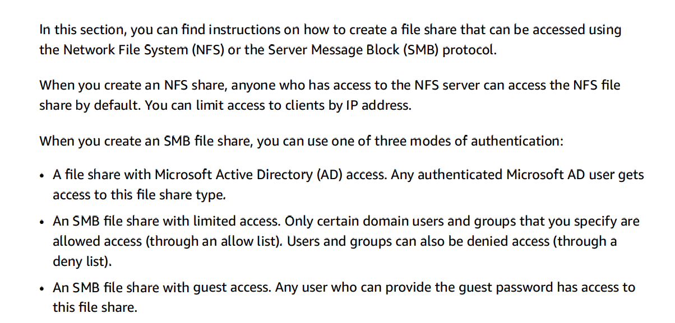
Creating a file share

Slide 20
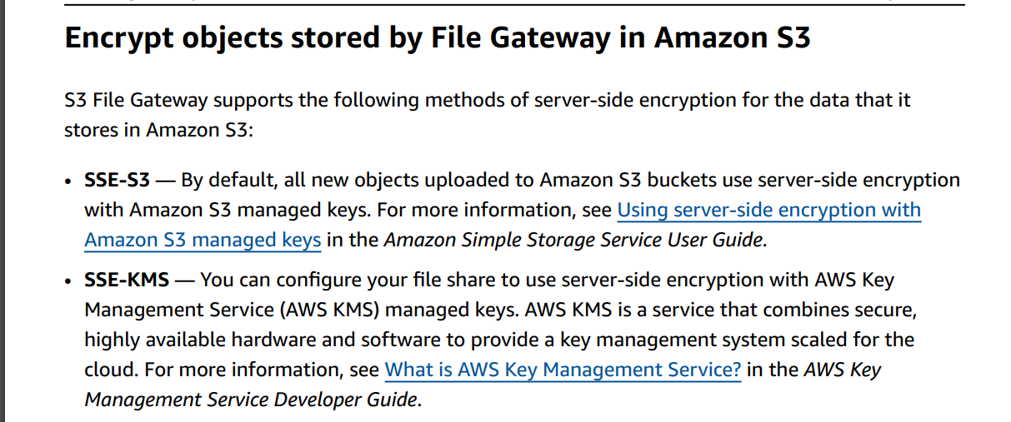
..

Slide 21
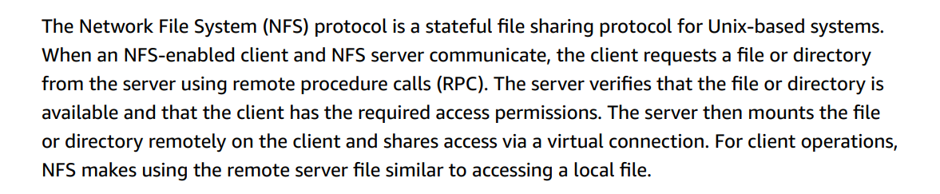
Create nfs share

Slide 22
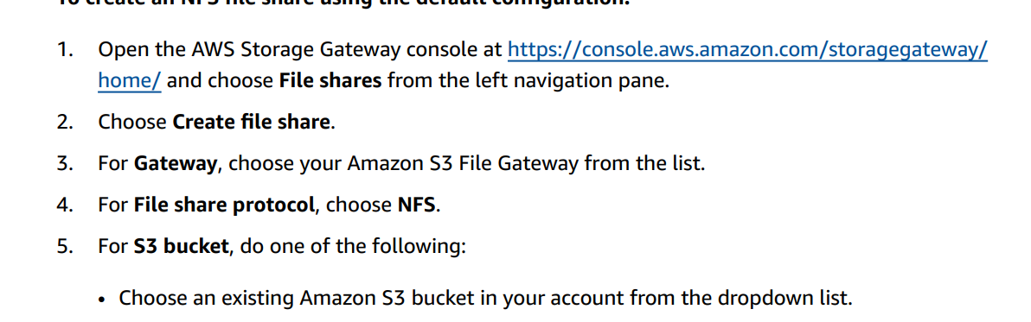
..

Slide 23
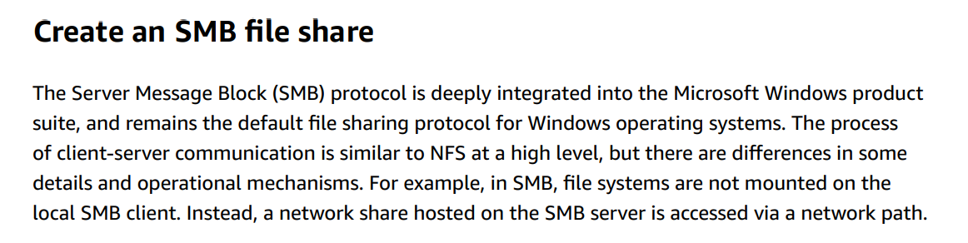
smb

Slide 24
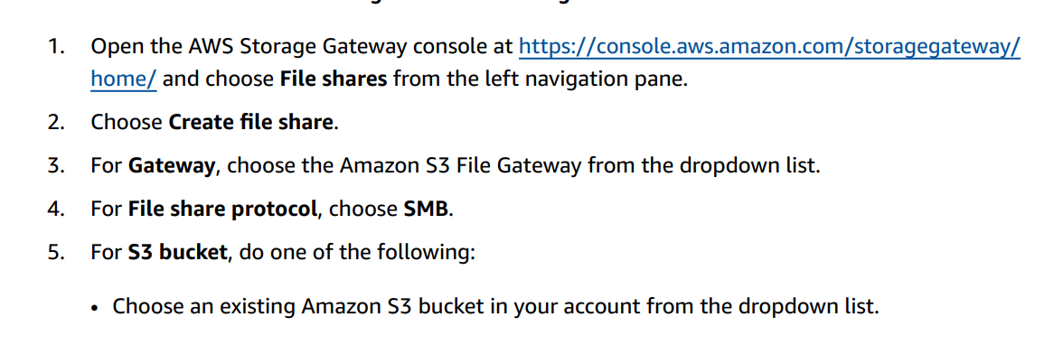
..

Slide 25
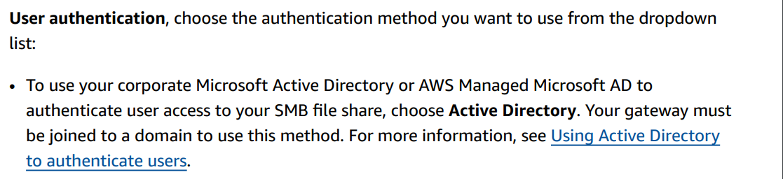
..

Slide 26
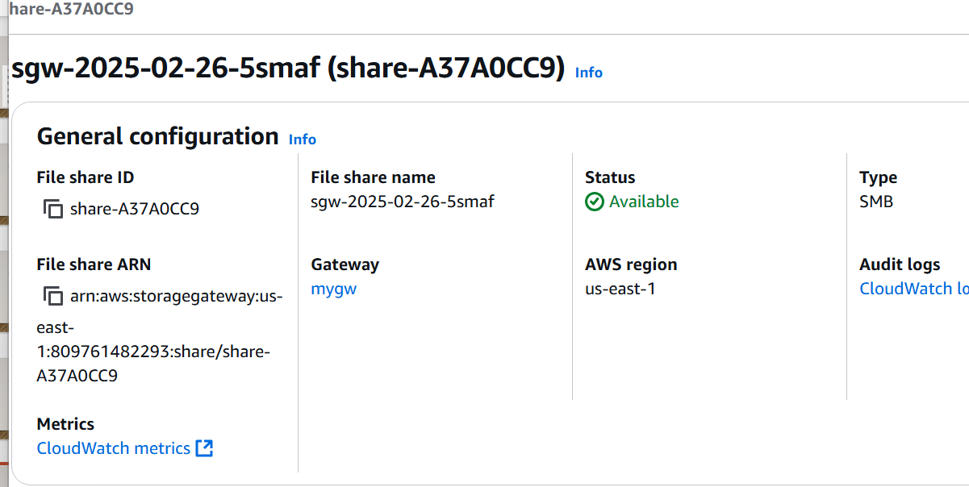
..

Slide 27
lab

Slide 28
How the Cache Disk Works
When an application writes data to AWS storage, the gateway initially stores it on the cache disk. The data is then uploaded to Amazon S3 by the gateway. When an application requests data, the gateway first checks the cache disk before retrieving it from Amazon S3.
When an application writes data to AWS storage, the gateway first stores it on the cache disk.
The gateway then uploads the data to Amazon S3.
When an application requests data, the gateway first checks the cache disk before checking Amazon S3.

Slide 29
Size of cache
Allocate at least 20% of your existing file store size as cache storage.
Make sure the cache storage is larger than the upload buffer.
You can use Amazon CloudWatch to monitor the cache storage usage.
If necessary, you can provision additional storage through the console.

Slide 30
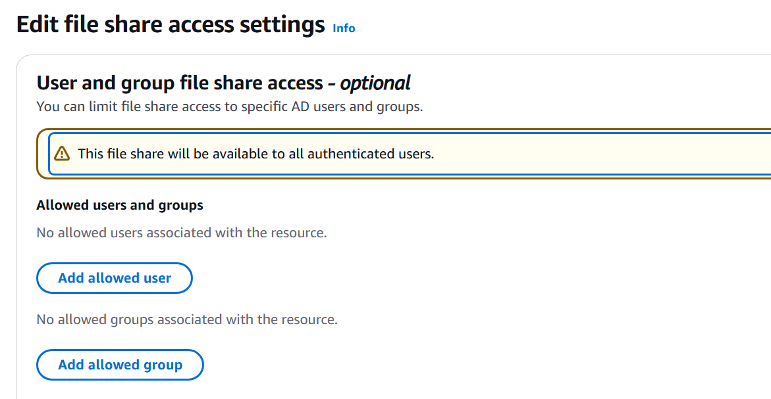
Access management

Slide 31
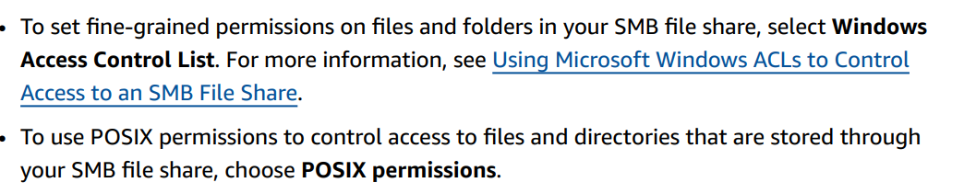
..

Slide 32
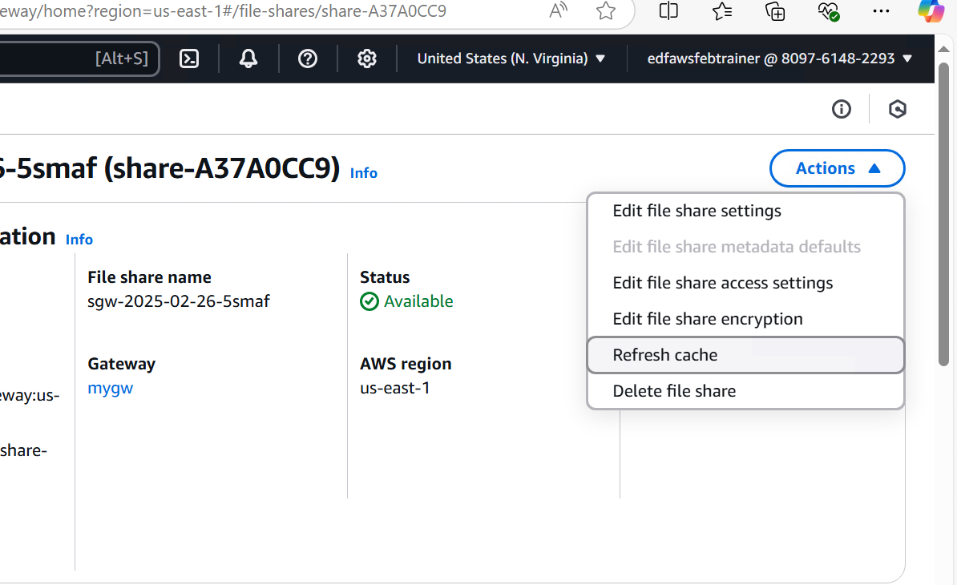
Refresh cache

Slide 33
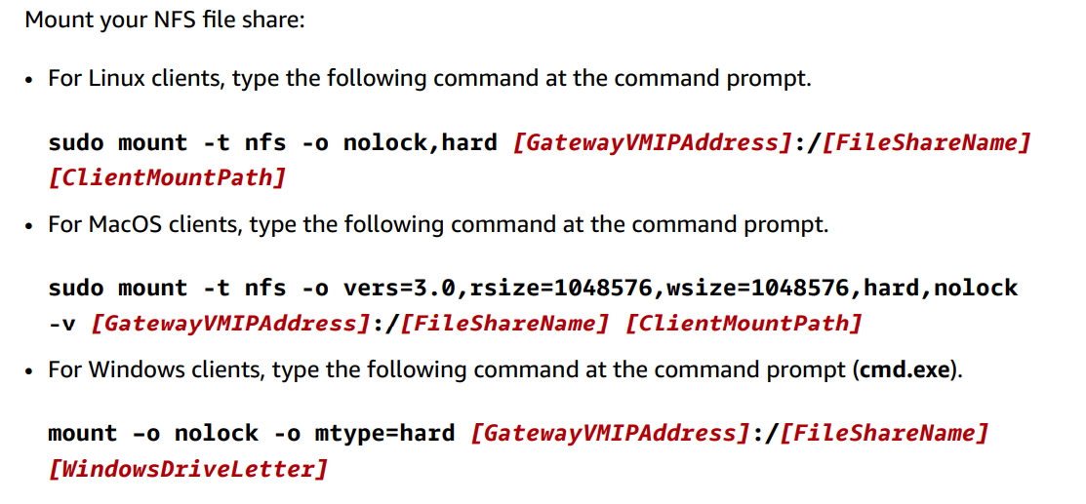
mounting

Slide 34
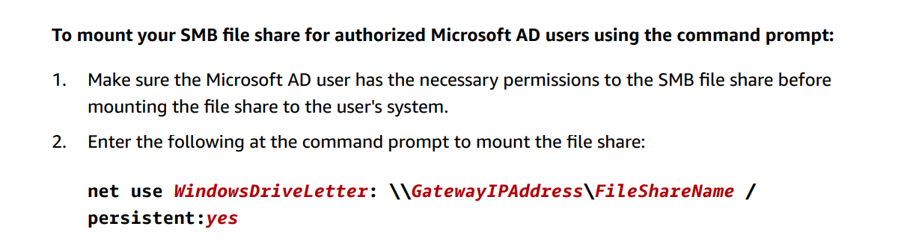
..

Slide 35
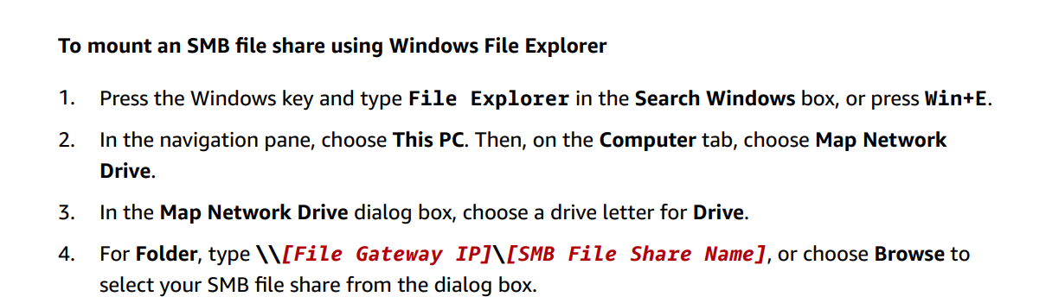
..

Slide 36
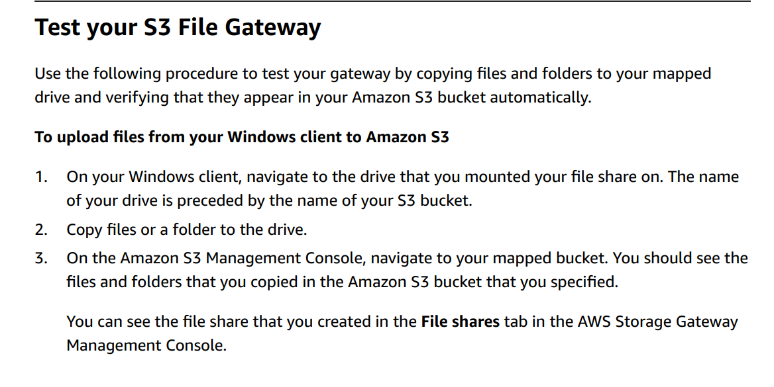
Test gateway

Slide 37
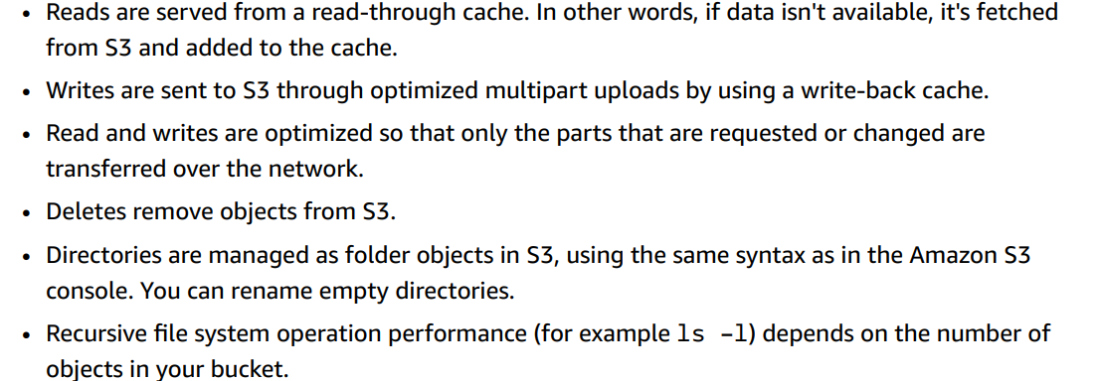
..

Slide 38
lab
Copy and delete the data

Slide 39
Setup cloudwatch
Aws Cloudwatch watches the aws resources, collecting data, and providing insight into health and performance.
AWS Storage Gateway provides CloudWatch metrics for monitoring performance, availability, and health. These metrics can help you track storage usage, I/O performance, and request rates.
We can setup alarms and alerts.
It helps for troubleshooting and identify the issue in aws environment.
Proactive alerts helps to fix the issue.

Slide 40
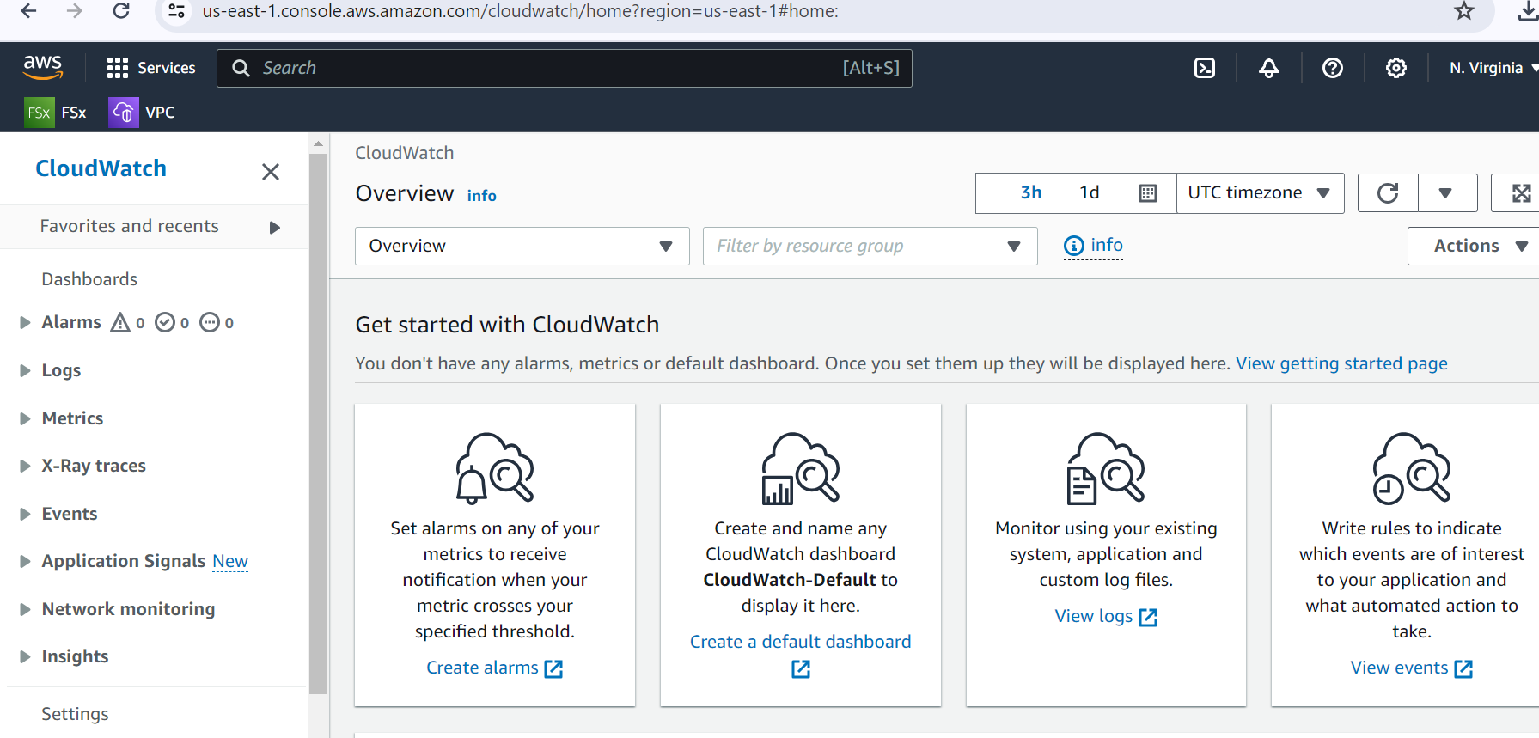
Cloudwatch

Slide 41
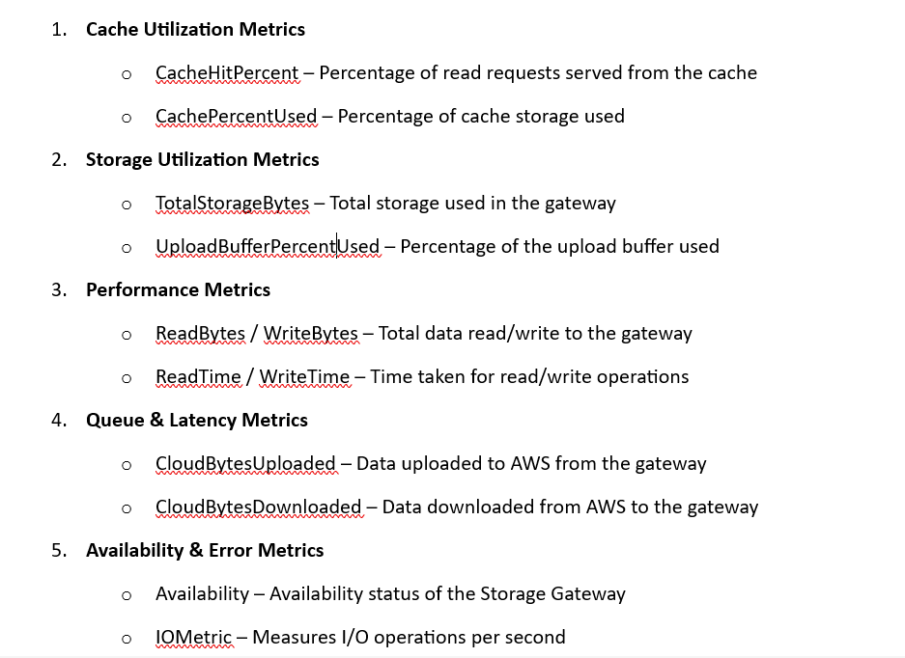
Key CloudWatch Metrics for Storage Gateway

Slide 42
Setup alarms
How to Use CloudWatch with Storage Gateway?
• Set up Alarms: Configure CloudWatch Alarms to notify when cache is full or upload buffer usage is high.
• Create Dashboards: Visualize metrics in CloudWatch dashboards.
• Enable Logging: Use CloudWatch Logs for deeper analysis of gateway events.

Slide 43
labs

Slide 44
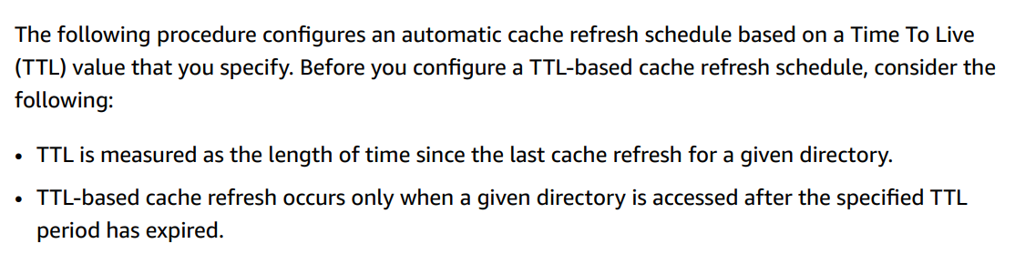
Configure cache

Slide 45
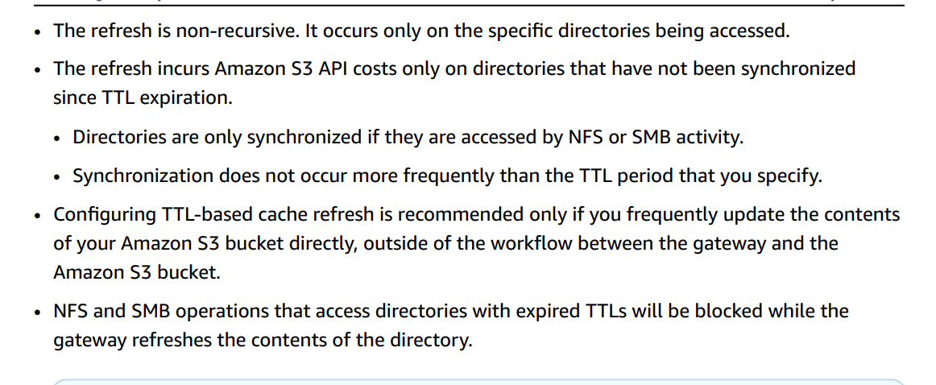
..

Slide 46
lab
Using lambda configure ttl

Slide 47
Replicate s3 lifecycle
Store an object → Upload an object to an S3 bucket.
Enable versioning for S3 → Turn on versioning for the bucket (if not already enabled).
Change object storage class from Standard to Glacier → Move the object to Glacier for cost efficiency.
Delete the object from S3 and File Share → This creates a delete marker in a versioned S3 bucket.
Restore → If the object was moved to Glacier, initiate a restore operation.
Delete the delete marker → This will make the previous version of the object the current version again.
Check if the resource is available → Confirm that the restored object is accessible.

Slide 48
lab
Manually
Automation

Slide 49
Cloud watch log groups
Health logs in Amazon CloudWatch provide critical insights into the performance and status of your S3 File Gateway. These logs help in monitoring, troubleshooting, and optimizing gateway operations.
Benefits of Enabling Health Logs
Proactive Issue Detection
Identify failures such as upload errors, latency issues, or gateway disconnects.
Detect when the gateway fails to transfer files to S3.
Automated Monitoring & Alerts
Use CloudWatch Alarms to receive notifications (via SNS) when critical events occur.
Set thresholds to get alerted when error rates exceed limits.

Slide 50
..

Slide 51
lab
Setup log groups

Slide 52
Managing gateway updates
Storage Gateway has two components
Managed cloud services component (AWS-side)
No Downtime:
AWS applies updates without disrupting deployed gateways.
Cloud-side updates are seamless and require no user action.
Gateway appliance component (deployed on-premises or on Amazon EC2).

Slide 53
..
Maintenance Updates (Scheduled, Monthly)OS and software upgrades.
Security patches, stability improvements.
New features.
Urgent Updates (As Needed)Fixes for critical security, performance, or stability issues.
Can be deployed anytime, outside the maintenance cycle.

Slide 54
..
For gateway appliances (deployed on-premises or in EC2), updates can briefly disrupt service.
Temporary Unavailability The gateway itself restarts during updates, causing a short outage.The VM host does not reboot, only the gateway service restarts.
Maintenance Window AWS sets a default maintenance window when you deploy the gateway.You can modify the schedule anytime to fit your needs.
Update Control Options You can disable automatic maintenance updates, but it's recommended to keep them enabled for security & performance fixes.
Manual updates can be done if auto-updates are turned off.Impact on WorkloadsScheduled updates may cause brief downtime during the restart.Ensure critical workloads are resilient to short disruptions.

Slide 55
Lab
Storage GW update

Slide 56
Know the aws cmd
Basic troubleshooting
Check status from cmd
Put basic script around the cmd
Use aws cli in cloudshell

Slide 57
Getting Notified About File Operation
File Upload Completion Notification
When a file is successfully uploaded from the file share to Amazon S3, a notification can be sent.
This is controlled using the NotificationPolicy parameter.
Each file upload generates an individual notification.
Example Use Case: A system that triggers additional processing when a file is uploaded.

Slide 58
Working File Set Upload Completion Notification
Instead of individual file notifications, this notifies you when all files in a working set have been uploaded.
This is enabled using the NotifyWhenUploaded API operation.
Example Use Case: A batch job that processes files only after all required files are uploaded.

Slide 59
Cache Refresh Completion Notification
When the RefreshCache operation is triggered, this notification is sent once the cache is updated.
This ensures that the on-premises system always accesses the most up-to-date data from Amazon S3.
Example Use Case: Systems that rely on frequent cache updates to work with the latest file versions.

Slide 60
LAb
sns

Slide 61
File share metrics
File share metrics in AWS Storage Gateway help you monitor the performance and usage of specific file shares. These metrics are similar to gateway-level metrics but focus only on individual file shares.
When using these metrics, always specify whether you are looking at gateway-level or file share-specific data. To monitor a particular file share, you need to use its File Share ID.
You can view these metrics in Amazon CloudWatch for better insights into your file share's activity and performance.

Slide 62
..
CacheHitPercent: Shows the percentage of file share read requests served from cache. A higher value means better performance.
CachePercentDirty: Indicates the percentage of cached data not yet saved to AWS. A lower value is preferable to avoid data loss risks.
CachePercentUsed: Shows how much of the gateway's cache storage is currently in use. A high value means the cache is almost full.
CloudBytesUploaded: Indicates the total amount of data uploaded from the gateway to AWS during the reporting period. A higher value suggests more data is being synchronized.

Slide 63
..
CloudBytesDownloaded: Tracks the total amount of data (in bytes) that the gateway has downloaded from AWS during the reporting period. This helps measure throughput and input/output operations per second (IOPS).
FilesFailingUpload: Monitors the number of files that are failing to upload to AWS. If this metric increases, it may indicate an issue with connectivity or storage. Health notifications provide more details about the failures.

Slide 64
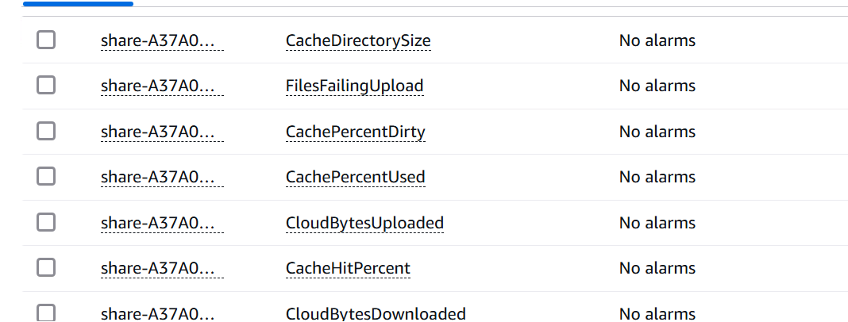
..

Slide 65
Batch jobs
Amazon S3 Batch Operations allow you to perform large-scale actions on millions or billions of objects stored in Amazon S3. Instead of writing custom scripts or applications to process each object individually,
S3 Batch Operations let you automate tasks efficiently.

Slide 66
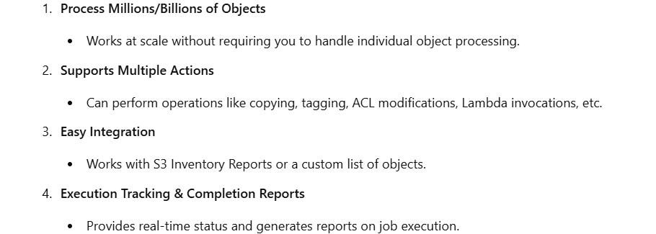
..

Slide 67
lab
Batch operation

Slide 68
Replacing Your Existing S3 File Gateway with a New Instance
You can replace an existing S3 File Gateway with a new instance to accommodate growing data and performance demands or in response to an AWS notification prompting migration.
This may be necessary if you want to transition your gateway to a more efficient host platform, upgrade to a newer Amazon EC2 instance, or update the underlying server hardware.
There are two approaches to replacing an S3 File Gateway

Slide 69
..
Method 1: Migrate Cache Disk and Gateway ID
How it works: Keeps the existing cache disk, so data is already available.
Best for: If your gateway has a large cache or if your applications need quick access to cached data.
Downtime: The gateway will be offline for 1-2 hours during migration.
Method 2: New Instance with Empty Cache
How it works: A fresh instance is set up, and data is downloaded again from AWS Cloud.
Best for: Workloads that are write-heavy and can handle delays in reading from the cloud.
Downtime: File shares remain available, but there will be a short cutover delay when switching between file shares.

Slide 70
Lab guide

Slide 71
Basic troubleshooting Authetication
The image shows an AWS IAM authorization error related to AWS Storage Gateway (SGW). This error occurs when a user tries to perform an action on a resource but lacks the necessary IAM permissions.
Explanation: The user (IAM user) attempted to perform the action sgw:GetWidget on the resource my-example-widget.
However, their IAM role or policy does not grant permission for this action.As a result, AWS denies the request, displaying the error message.

Slide 72
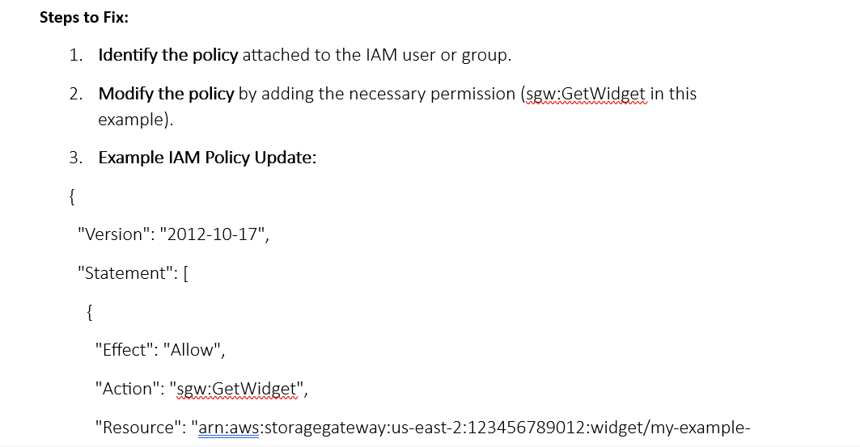
..

Slide 73
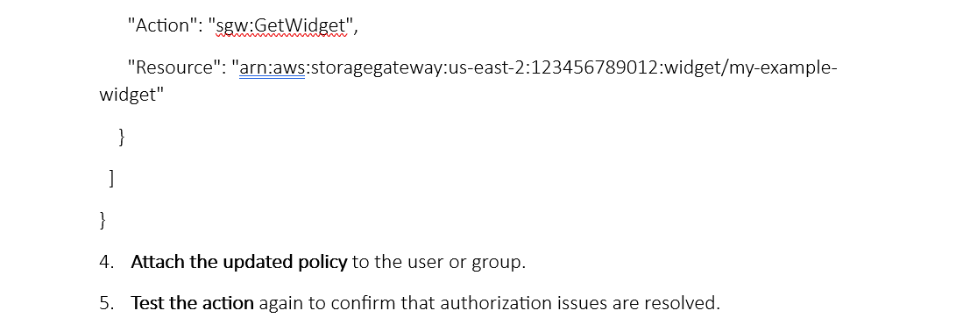
..

Slide 74
Gateway issue
The gateway cannot reach AWS Storage Gateway service endpoints (network issue).
The gateway unexpectedly shut down (power or system failure).
A cache disk associated with the gateway is disconnected, modified, or has failed (hardware or disk issue).

Slide 75
..
Identify the root cause and resolve the issue.
Check network connectivity (firewall, proxy settings).
Ensure the cache disk is properly attached and functioning.
Restart the Storage Gateway service if needed.

Slide 76
Cloud trail
CloudTrail Activation:
CloudTrail is automatically enabled when you create an AWS account.
It records activities in AWS services, including Storage Gateway.
You can view, search, and download recent events from CloudTrail Event History.
Creating a CloudTrail Trail:
A trail allows CloudTrail to store log files in an Amazon S3 bucket.
y default, a created trail applies to all AWS Regions.
Events from all AWS Regions are collected and stored in the specified S3 bucket.
The logs can be used for further analysis and monitoring.

Slide 77
..
Why is this important?
CloudTrail helps in tracking changes, security audits, and troubleshooting AWS services.
If you're working with AWS Storage Gateway, you can use CloudTrail logs to monitor actions and investigate any unauthorized activity.

Slide 78
Aws cloudformation
ow

Slide 79
overview
AWS CloudFormation is a service that helps you model and set up your Amazon Web Services resources so that you can spend less time managing those resources and more time focusing on your applications that run in AWS.
You create a template that describes all the AWS resources that you want (like Amazon EC2 instances or Amazon RDS DB instances), and AWS CloudFormation takes care of provisioning and configuring those resources for you.

Slide 80
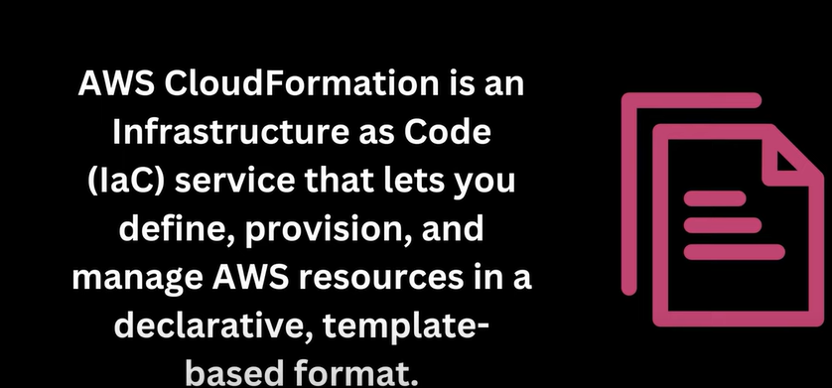
Definition

Slide 81
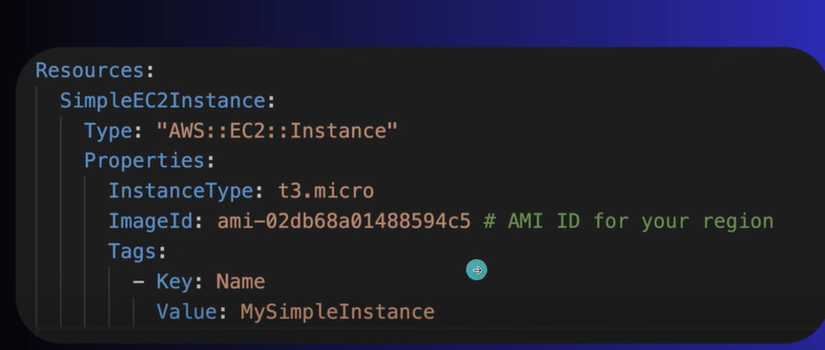
Template

Slide 82
..
Open your favorite text editor and create a CloudFormation template in either JSON or YAML format.
2. Define the structure of your CloudFormation template, which includes specifying the resources you want to create. For an EC2 instance, you should use the `AWS::EC2::Instance` resource type.
3. Define the properties for the EC2 instance, such as the instance type, key pair, security groups, and any other configuration details.

Slide 83
..
- Resources: These are the AWS resources you want to provision, such as EC2 instances, S3 buckets, RDS databases, etc. — Parameters: These are input values that can be customized when creating a stack. — Mappings: Define a mapping between input values and corresponding resource properties. — Conditions: Specify when resources should be created or when they should be skipped. — Outputs: Declare the values you want to retrieve once the stack is created.

Slide 84
AWS CloudFormation Basics:
In CloudFormation, you work with Templates and Stacks.
Template: JSON or YAML formatted text file which is a blueprint of your AWS resources.
Stack: In CloudFormation, you manage resources as a single unit called a Stack. All the resources in a stack are defined by the stack’s Template.
Hence the AWS CloudFormation workflow can be summarized using the image here.

Slide 85
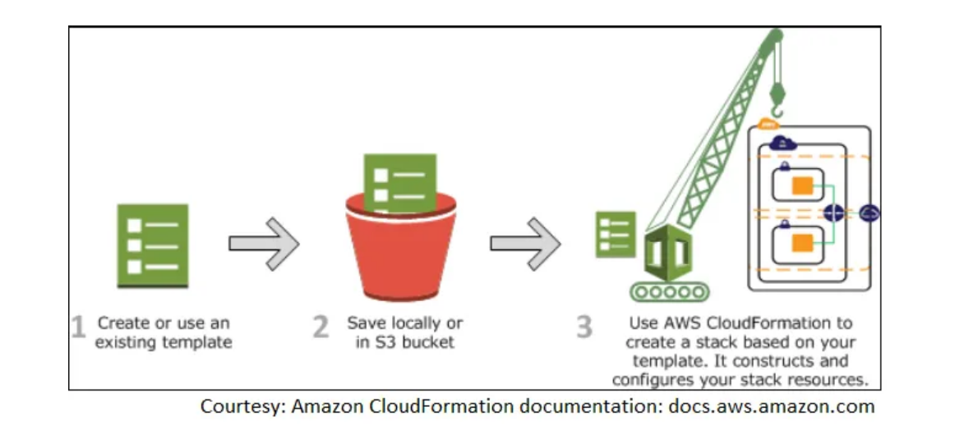
..

Slide 86
template
A template is a JSON or YAML formatted text file that describes what resources are contained in the Stack. It contains information about each resource, its configuration and how it may be connected or dependent on other resources.
A template can be developed using two methods:
1. UI Designer: You can diagram your template resources using a drag-and-drop interface, and then edit their details using the integrated JSON/YAML editor.
2. Script: Directly scripting the template in JSON or YAML format.

Slide 87
Description of template
Description: Enables you to include arbitrary comments about your template. (Optional)
Parameters: Parameters enable you to input custom values to your template each time you create or update a stack. (Optional)
Mappings: Collection of Key-Value pairs which can be used to set values. (Optional)
Resources: Declares the AWS resources that you want to include in the stack. (Required)
Outputs: Declares output values that you can import into other stacks, return in response, or view on the AWS CloudFormation console. (Optional)

Slide 88
benefit
Simplify Infrastructure Management
Quickly Replicate Your Infrastructure
Easily Control and Track Changes to Your Infrastructure

Slide 89
𝐃𝐫𝐢𝐟𝐭 𝐃𝐞𝐭𝐞𝐜𝐭𝐢𝐨𝐧:
- Drift detection in CFT allows you to identify differences between the desired stack configuration defined in your template and the current stack resources. — It helps you track changes and understand if the stack has drifted from its expected state. — Drift detection is useful for ensuring that your infrastructure stays compliant with your defined configurations.

Slide 90
𝐇𝐨𝐰 𝐭𝐨 𝐖𝐫𝐢𝐭𝐞 𝐂𝐅𝐓𝐬:
- Use the JSON or YAML template format to define your AWS resources, parameters, and other template components. — Define the resource properties, dependencies, and other settings for each resource. — Use CloudFormation intrinsic functions like `Fn::Ref`, `Fn::GetAtt`, and `Fn::Sub` for dynamic configurations. — Use AWS-specific extensions like `!Sub` and `!ImportValue` for parameterization and cross-stack referencing. — Use conditions to control resource creation and to make your templates more flexible.

Slide 91
𝐄𝐱𝐚𝐦𝐩𝐥𝐞𝐬 𝐨𝐟 𝐂𝐥𝐨𝐮𝐝𝐅𝐨𝐫𝐦𝐚𝐭𝐢𝐨𝐧 𝐔𝐬𝐞 𝐂𝐚𝐬𝐞𝐬:
- Creating a VPC and related resources: Define a VPC, subnets, security groups, and routing tables. — Deploying an application stack: Define EC2 instances, load balancers, databases, and other application components. — Setting up monitoring and alarms:*Define CloudWatch alarms, SNS topics, and metric filters. — Provisioning storage resources: Define S3 buckets, EBS volumes, and RDS databases. — Managing security and compliance: Define IAM roles, policies, and security group rules.

Slide 92
Lab
CFT

